Slide 1

DevOps & Cloud Infrastructure SEIS 665 Week 6
Jason Baker
Adjunct Instructor
Graduate Programs in Software
University of St. Thomas
St. Paul, MN

Slide 2
Agenda
Midterm Exam
AWS
Cloud Watch
EC2 user data
EC2 Auto-scaling
ElastiCache
SNS
SQS
SES
Route 53
Elastic Beanstalk
AWS Security

Slide 3
Midterm Exam
Covers lectures 1-6 and related assignments.
Study guide posted to Blackboard.
Closed book
30 multiple choice, 20 true/false.

Slide 4
RDS Hands-on
Launch RDS instance

Slide 5

CloudWatch
CloudWatch is a monitoring service for AWS resources and applications.
Track performance metrics
Collect and monitor log files
Set alarms based on predefined thresholds
Supports EC2, RDS, DynamoDB, and other services.
Basic monitoring is free, detailed monitoring costs extra.
Increased interval from 5 min to 1 min
Monitor custom app metrics using an API

Slide 6
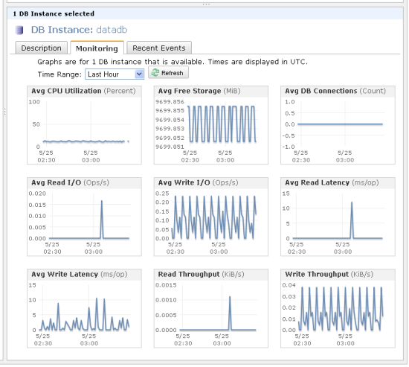
CloudWatch Instrumentation

Slide 7

CloudWatch Hands-on
View Metrics
EC2 instance CPU utilization
RDS database read IOPS
Create Alarm
S3ObjectCount: alarm when number of S3 objects in a bucket is over 1000

Slide 8
CloudTrail
A service that logs all AWS API calls for tracking, reporting and compliance purposes.
A stream of logging data is called a trail.
Log data is stored in a designated S3 bucket.
Trail can contain logs from all regions or a specified region.
Maximum of 5 trails per region.
Ability to setup notification when specific API calls are made.
Example: Notify when API call adds or removes EC2 instances.

Slide 9
AWS Config
A service that evaluates and documents the configuration of AWS resources.
Can review resources globally or just in a specific region.
Can review all resources or just selected ones.
Use cases:
Take snapshots of resource configurations to review changes over time.
Audit resource configuration for compliance purposes.
Verify that all EBS volumes are encrypted.
Verify that resources are tagged properly.
Reports are stored in a designated S3 bucket.
Service can send notifications if a resource configuration changes.

Slide 10
EC2 User Data
User Data is a set of shell script commands automatically executed by the instance during the initial launch.
Commands are executed as root, so sudo is not needed.
Commands are supplied via text entry or stored in a file.
Benefit: automate installation and configuration of instance.

Slide 11
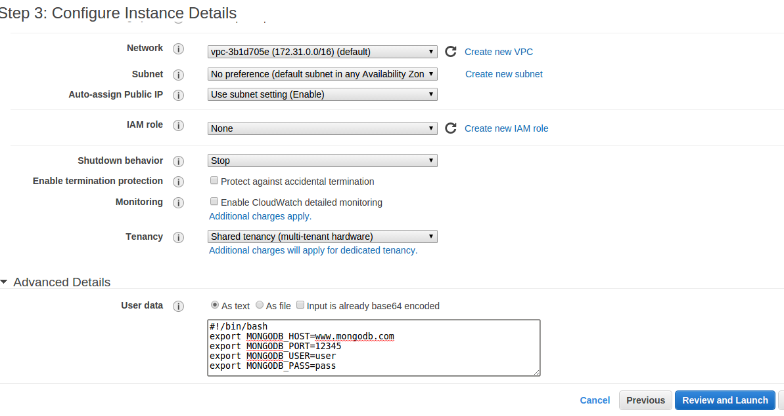
EC2 User Data

Slide 12
EC2 Auto Scaling
Auto scaling allows you to scale EC2 capacity up or down based on defined conditions.
Ensure a certain number of instances are always running.
Increase or decrease number of instances to support current demand and save costs.
Only billed for instances created by Auto Scaling, not the service itself.

Slide 13
EC2 Auto Scaling
Two components of auto scaling configuration:
Launch Configuration: specifies the type of EC2 instance created during the auto scaling process.
Very similar to launching an EC2 instance, in this case just the configuration is created.
Auto Scaling Group: defines a set of EC2 instances and the the conditions which determine the number of instances in the set.

Slide 14
EC2 Auto Scaling
Auto Scaling Group configurations:
Maintain minimum number of instances: automatically launches new instances if a current instance becomes unhealthy.
Manual scaling: user manually changes auto scaling group configuration and AWS adjust instance count to match new configuration.
Dynamic scaling: instances launched or removed based on CloudWatch metrics and alarms.

Slide 15
Auto Scaling Hands On
Create a launch group.
Create an auto scaling group.
Group size = 2
Keep group at its initial size
Watch AWS automatically launch EC2 instances.
Manually fail one of the instances and watch automatic recovery.

Slide 16
ElastiCache
ElastiCache is a distributed in-memory caching system.
Huge performance improvement when reading from memory vs. disk.
Main memory reference = 100 ns
Read 4k randomly from SSD = 150,000 ns
Benefits:
Cache frequent database queries
List of US states
Product listing
Store frequently-accessed data
Web sessions

Slide 17
ElastiCache
Supports two types of cache systems:
Memcached
Redis
Memcached
Very reliable key/value store
Simple to operate and use
Redis has more features today
Storing data in a variety of formats beyond key/value: list, array, sets, and sorted sets
More complex to operate
AWS supports master/slave replication and cross AZ redundancy

Slide 18
Memcached Example
telnet mycachecluster.eaogs8.0001.usw2.cache.amazonaws.com 11211
Trying 128.0.0.1...
Connected to mycachecluster.eaogs8.0001.usw2.cache.amazonaws.com.
Escape character is '^]'.
>
set a 0 0 5 // Set key "a" with no expiration and 5 byte value
hello // Set value as "hello"
STORED
get a // Get value for key "a"
VALUE a 0 5
hello
END
get b // Get value for key "b" results in miss
END
>

Slide 19
Redis example
redis-cli -h mycachecluster.eaogs8.0001.usw2.cache.amazonaws.com -p 6379
set a "hello" // Set key "a" with a string value and no expiration
OK
get a // Get value for key "a"
"hello"
get b // Get value for key "b" results in miss
(nil)
quit // Exit from redis-cli

Slide 20

Simple Notification Service (SNS)
SNS makes it easy to publish messages from an application and deliver them to subscribers or other applications.
Send messages via:
Email
SMS (text message)
Mobile push (Apple, Google, Fire OS, Windows)
SQS queues
HTTP endpoints

Slide 21
SNS
A topic is created as an access point to allow multiple recipients to receive a message.
A single topic can support multiple endpoint types
Messages published to SNS are stored in multiple AZs for redundancy.
Recipients must subscribe to a topic in order to receive published messages.
Messages are pushed to topic recipients.
Use-cases: event notifications (triggers, alerts, auto scaling notifications, etc.)

Slide 22
SNS Hands-on
Create a new topic.
Add a recipient to the topic.
Publish a message.

Slide 23

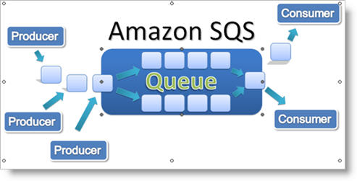
Simple Queue Service (SQS)
SQS is a distributed queue system that allows messages generated by one system component to be consumed by another.
First web service launched by Amazon in 2005.
Asynchronous application integration: message producers are decoupled from consumers

Slide 24
SQS
SQS use cases:
Create thumbnails from user uploaded images or apply watermarks.
Video transcoding
Support payment process workflow for orders.
Scale bursty applications that are trying to balance data consumption with backend data processing.
Messages are added to a queue by an application, and then pulled from the queue by another application.
Consumer app must process message within a certain amount of time called the visibility timeout.
Consumer app must delete the message from the queue when complete.

Slide 25
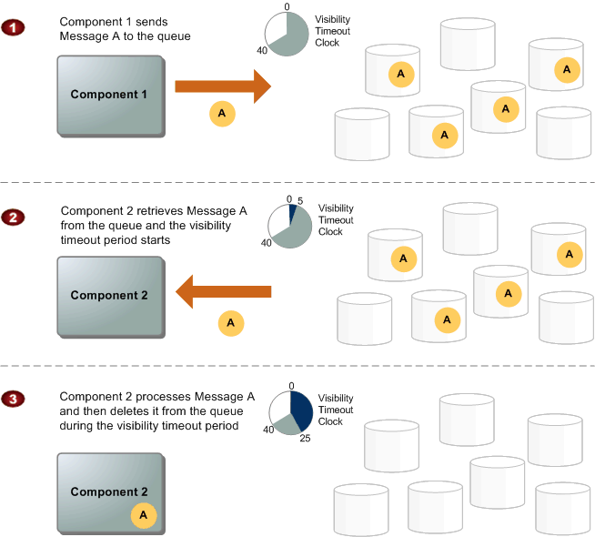

Slide 26
SQS
SQS guarantees that a message will be received at least once (but possibly more than once!)
Action taken on message should be idempotent (repeat action multiple times with same result).
Because messages are pulled, requests must be made every few seconds to see if anything in the queue.
1 request every 5 sec = 12*60*24*7*4.3= 520,128/mo
4 backend workers > 2 million requests/mo
Wasteful requests if queue is empty at times
Long polling: keep message pull call open for up to 20 seconds, streaming in new messages as they arrive.

Slide 27
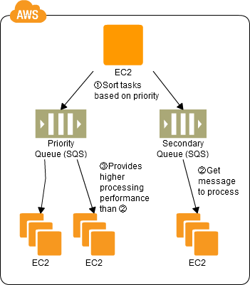
SQS Priority Queuing
SQS doesn’t support the concept of prioritization, but you can use multiple queues to accomplish the same thing.

Slide 28
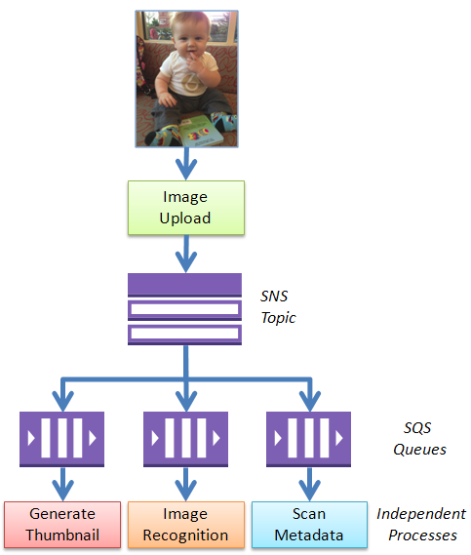
SQS Fan-out

Slide 29

Simple Email Service (SES)
SES is a scalable email service to support sending and receiving email from AWS.
Building and maintaining a scalable email platform is challenging and expensive (personal experience).
Building a secure platform is tricky
Spam and virus filtering expensive
AWS customers must get approval to run mail servers (smtp) on EC2 instances.
Service providers have to constantly combat abuse by spammers leveraging platform
Public IP addresses eventually get blacklisted by spam monitors eventually leading to blacklisting of entire networks

Slide 30
Simple Email Service (SES)
Messages sent via standard SMTP, received messages are stored in S3.
SES provides greater message delivery assurance by supporting authentication mechanisms:
Sender Policy Framework (SPF)
DomainKeys Identified Mail (DKIM)
Both use DNS records to verify that SES is allowed to send email on behalf of the domain owner.
Billing is based on number of messages sent and received per month (first 62k sent free).
AWS places a limit on number of messages sent/day, but you can request an increase.

Slide 31

Route 53
Scalable domain name hosting and registration service.
Route 53 name is based on famous Route 66 highway across America, 53 is DNS port number.
Domain Name Services (DNS) are a critical part of Internet infrastructure
DNS translates domain names (domain.com) into IP addresses.
Availability of DNS services directly impacts service availability.
Service isn’t really “up” if nobody can find it.

Slide 32
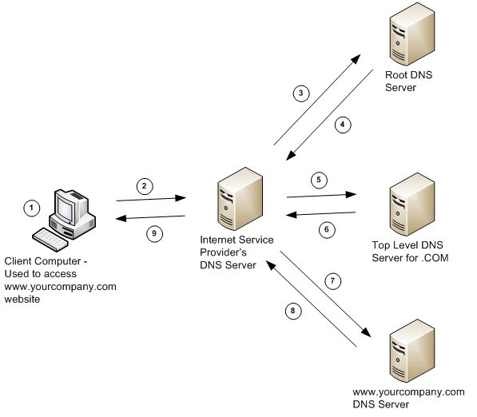
Route 53
How DNS Works

Slide 33
Route 53
AWS can serve as a domain registrar and name server.
A name server provides all authoritative records for a domain name.
Record types:
Start of authority (SOA): administrator name, version, and TTL information
Name Server (NS): used by top level servers to locate authoritative name server
Address (A): maps a hostname to an IP address
CNAME: maps a hostname to a fully qualified domain name
Alias: like a CNAME, but can use dynamic AWS targets
Example: Elastic load balancers use a dynamic endpoint, not an IP address

Slide 34
Route 53 Routing Policies
Routing policies are used to distribute traffic over multiple regions using dynamic DNS responses.
Simple: default policy which maps a DNS response to a single region .
Weighted: distribute traffic over multiple regions based on the weighting assigned to each region.
Example: 85% us-east, 15% us-west)
May be useful for A/B testing

Slide 35
Route 53 Routing Policies
Latency: distribute traffic by directing user to the lowest latency region.
Example: US customers directed to us-east and European customers direct to eu-west
Failover: monitor health of services and fail over to a secondary region if health check fails.
Example: us-east is primary, us-west is secondary
Primarily used for disaster recovery purposes, protect against failure of an entire region
Geolocation: distribute traffic to a specific region based on physical location of user.
Example: All queries from European users go to eu-west
Primarily used to meet regulatory and data privacy requirements

Slide 36
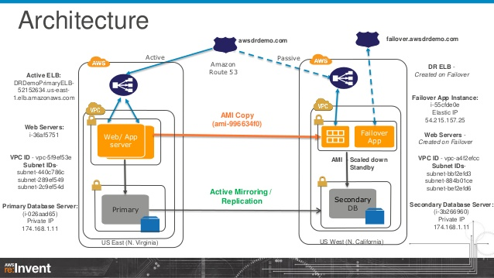
DR Architecture Using Route 53

Slide 37

Elastic Beanstalk
PaaS which automates the configuration and deployment of application stacks.
Automatically provisions and scales EC2, load balancing, networking, storage, and RDS.
Installs and manages application servers and frameworks.
AWS user just focuses on loading custom application.
Benefit: designed primarily for application developers that don’t want to deal with infrastructure.

Slide 38
Elastic Beanstalk
Application support:
Java
PHP
Python
Ruby
IIS/.NET
Node.js
Docker
EB controls capacity of resources, but you can still access infrastructure.

Slide 39
Elastic Beanstalk Deployment Policies
Deployment policies control how EB updates deployed application:
All at once: deploy application to all instances simultaneously (short service disruption).
Rolling: deploy new app in batches, reducing service capacity but causing no disruption.
Rolling with additional batch: launch new resources before batch updates so that service capacity isn’t reduced.
Immutable: deploy new application to a fresh group of instances (blue-green deployment).

Slide 40
Elastic Beanstalk Hands On
Deploy auto-scaling PHP platform using sample application.

Slide 41
Lambda
A compute service that automatically runs application code in response to events.
Server-less architecture (“NoOps”)
No compute, storage, networking, scaling, or security patching required.
Just write code and let Lambda handle it for you.
Billing based on every 100ms code is executing and number of times code is triggered.
Main use cases:
Extend functionality of existing AWS services
Automatically update Route 53 domain host record when a new EC2 instance is added.
Create entire application platforms
Web-based video training site
Real-time analytical processing

Slide 42
Lambda

Slide 43
Lambda

Slide 44
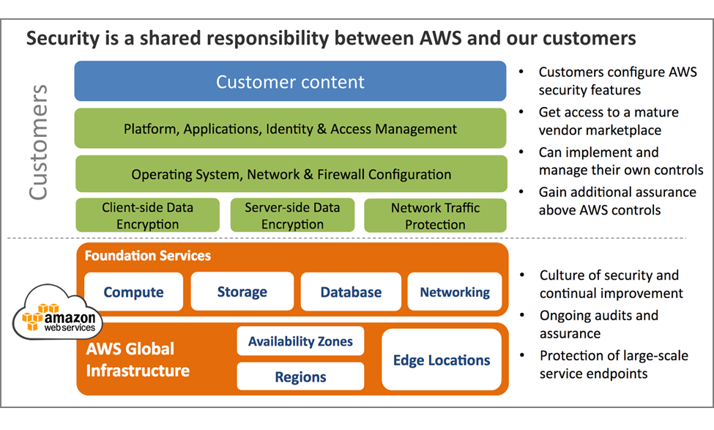
AWS Shared Security Model

Slide 45
AWS Network Security
AWS network and Amazon network use similar infrastructure, but are logically separated from one another.
AWS prevents IP spoofing: instance sending data with an IP or MAC address that’s not it’s own.
Network port scans must be approved by AWS in advance.

Slide 46

AWS Trusted Advisor
Originally an internal tool used by AWS consultants to audit customer service configuration.
Audits four aspects of deployed services:
Cost optimization
Performance
Security
Fault tolerance
Basic review available for free, advanced reports require a support plan.

Slide 47
Resource Groups
Resource Groups are collections of AWS resources that share tags.
Tags are user-definable metadata for resources
One or more tags may be used in a resource group
Benefit: easily view associated resources across the entire AWS platform.
Tag and group resources by organization or project
Group resources by owner

Slide 48
Homework
Study for Midterm Exam – Good Luck!
Due after Midterm Exam and by Week 8 class:
Assignment 6
Read Practice of Cloud Systems Administration Chapters 4 & 5
Please complete mid-term evaluation form.

